Slide 1
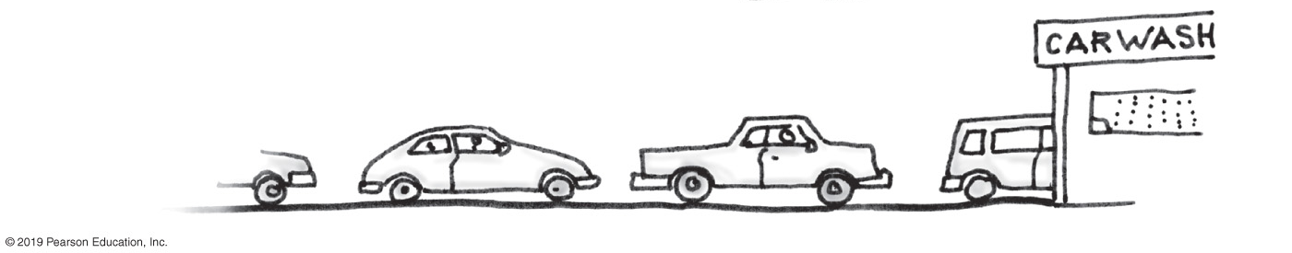
Chapter 7-8: Queues, Deques, and Priority Queues – Queue Implementation
Manar Mohamed
mohamem@miamioh.edu

Slide 2
In an array implementation of set with n elements, what is the time complexity of contains?
best case is O(1) and average case is O(1)
best case is O(1) and average case is O(n)
best case is O(n) and average case is O(n)
best case is O(n) and average case is O(n^2)

Slide 3
True or False? A stack is a good data structure for storing customers waiting in line at Kroger.
True
False

Slide 4
Customers waiting in line:
"First come, first served"
"First in, first out"
But stacks are "Last in, first out"
Making them a bad choice for people waiting in line
Queues are the solution:
Queues are "FIFO" (first in, first out….or first come, first served")

Slide 5
ADT Queue
FIFO data type
The first item added is the first removed
Methods for:
Adding to the end of the queue (enqueue, or put)
Removing from the front of the queue (dequeue, or get)
Peeking at the front of the queue (getFront, or peek)
Clearing the queue (clear)
Checking if the queue is empty (isEmpty)

Slide 6
Queue in your textbook:

Slide 7
FIGURE 7-2 The effect of operations on a queue of strings

Slide 8
Queue implementation:
We will look at implementations involving:
Linked nodes
Arrays
Circularly linked nodes

Slide 9
Queue vs. stack implementation
In stacks, all the action happens on one end:
Pushing to the top
Removing from the top
This meant we only needed an instance variable to keep track of one end of the data.
Unlike stacks, there is action on both ends of the queue data structure:
Adding to the end
Removing from the front
So, we will want instance variables to keep track of both ends

Slide 10
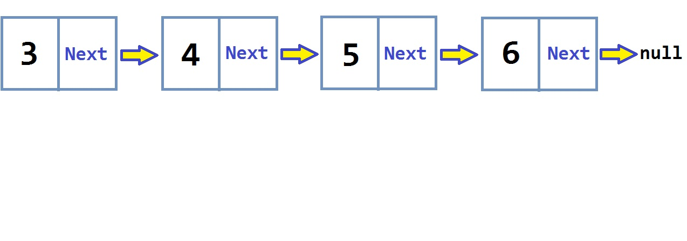
Linked Node Implementation of Queue
First, consider a chain of linked nodes…
Suppose you had references to both ends

Slide 11
Decision time:
In a queue, I have to add to one side, and remove from the other.
Should I:
Add each new node before first, and remove the last node? Or…
Add each new node after last, and remove the first node?
Or both are perfectly acceptable?

Slide 12
If you have references to the first and last nodes in a chain, which of these is NOT O(1)?
adding a node at the beginning
adding a node at the end
removing the first node
removing the last node

Slide 13
Removing the last node:
Requires changing the second-to-last node to make it point to null.
But the only way to get to the second-to-last node is to start at the first node and go almost until the end.
O(N)
Therefore, when implementing queue, we don't want to remove from the end.
That means…

Slide 14
How to implement queue with linked nodes:
Instance variables for first and last
When adding to the queue:
Create a new node
Point the last node to it
When removing from the queue:
Remove first node
Watch for edge cases
Adding to an empty queue
Removing the only node
Removing when there are no nodes (throw some kind of exception)

Slide 15
What about the size of the queue?
Should we have an instance variable for the size?
We don't normally need to know the size
We only care if it's empty or not
We can figure out if it's empty by looking at the head node. If it's null, the queue is empty.
Still, wouldn't it be nice to have that extra size variable?
No
Because having it means always maintaining its value. Why bother?

Slide 16
Array-based implementation of queue
Be warned:
This is kind of fun to think about.
It involves a useful "trick" you may not have thought of

Slide 17
Java has a Stack class but not a Queue class
Rather, Java has a Queue interface
And several classes that implement the interface, including…
LinkedList
The method names for the 5 operations are:
add(T) - to add an item to the end (exception if no space available)
remove() - remove the front item (exception if empty)
element() - peek at the front item (exception if empty)
isEmpty() - checks if empty
clear() - clears

Slide 18
What kind of exception is thrown?
Java does not have an EmptyQueueException
Instead, NoSuchElementException is thrown if the queue is empty and you call
remove()
element()
IllecgalStateException is thrown if no space available and you call
add()
Side note:
Java's Queue interface also has:
poll() - works like remove() but returns null if empty
peek() - works like element() but returns null if empty

Slide 19
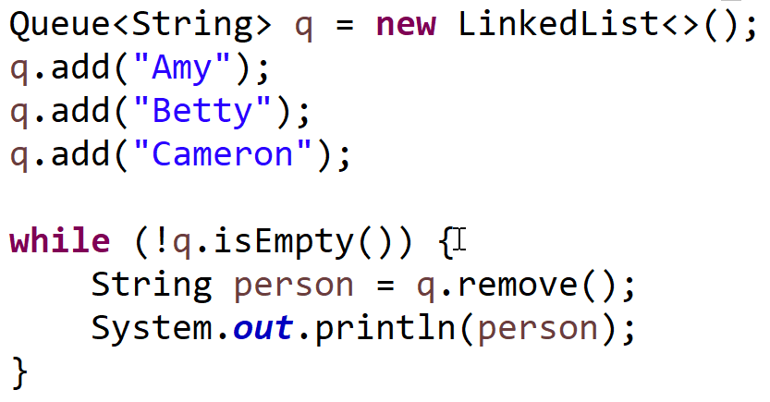
What will be the first name printed?
Amy
Betty
Cameron
None of the above

Slide 20
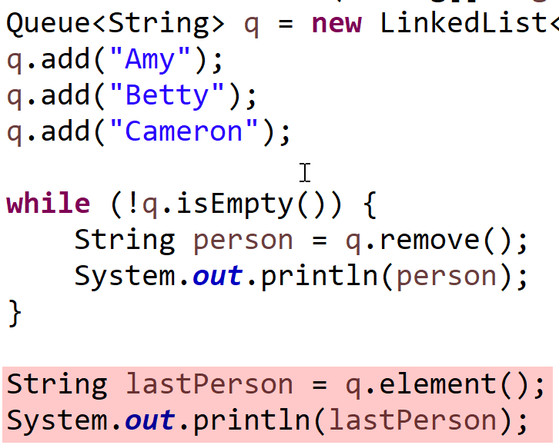
What happens below?
EmptyQueueException
EmptyStackException
NoSuchElementException
null is printed

Slide 21
What if we change q.element() to q.peek()?
EmptyQueueException
EmptyStackException
NoSuchElementException
null is printed

Slide 22
Don't get distracted by those details…
Just know that when you have an empty queue…
And try to remove or peek at the first element…
Java offers two choices…
methods that return null
methods that throw a NoSuchElementException
Which should you use? Depends on what you need

Slide 23
Kroger scenario:
Can you think of ANY situation at Kroger where the last person in line will be served next?
But a queue would not allow that.
Queues only allow:
Adding to the back
Removing from and peeking at the back
But what if you wanted to be able to:
Add to the front and the back
Remove from the front and the back
Peeking at the front and the back

Slide 24
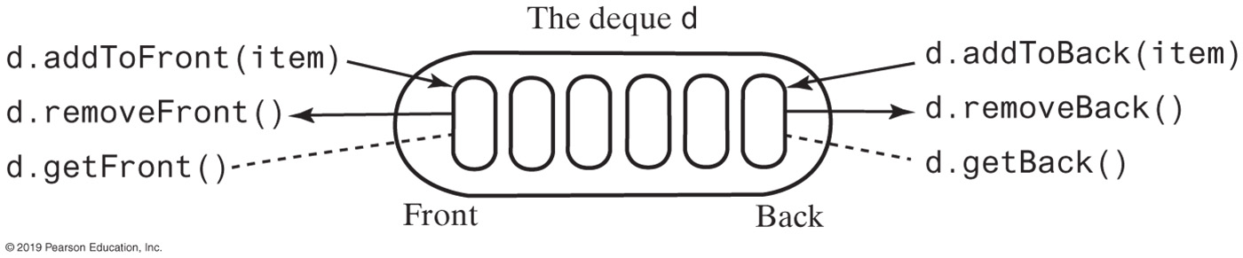
Deque to the rescue!
Deque - double-ended queue
Allows adding to either end
Allows removing from either end
Allows peeking at either end

Slide 25
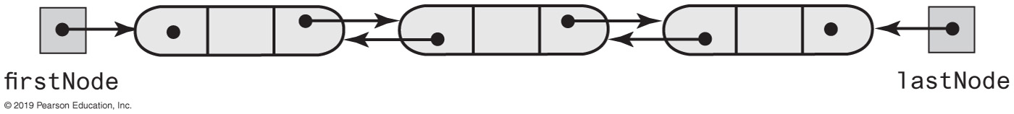
Doubly Linked Implementation of a Deque
FIGURE 8-17 A doubly linked chain with head and tail references

Slide 26
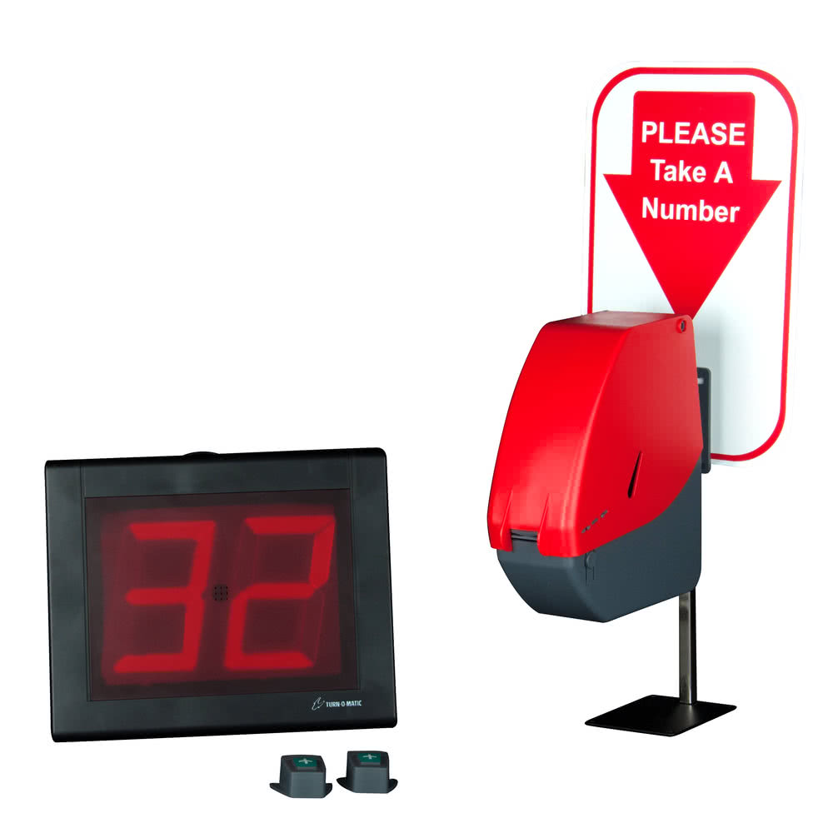
Priority queue:
Removing from a queue always removes the item from the front
In a priority queue, we remove the item with the highest priority
whatever that means…often it's the one with the lowest value
doesn't matter when it was placed in the queue
For example, you could prioritize based on:
height
age
alphabetical order

Slide 27
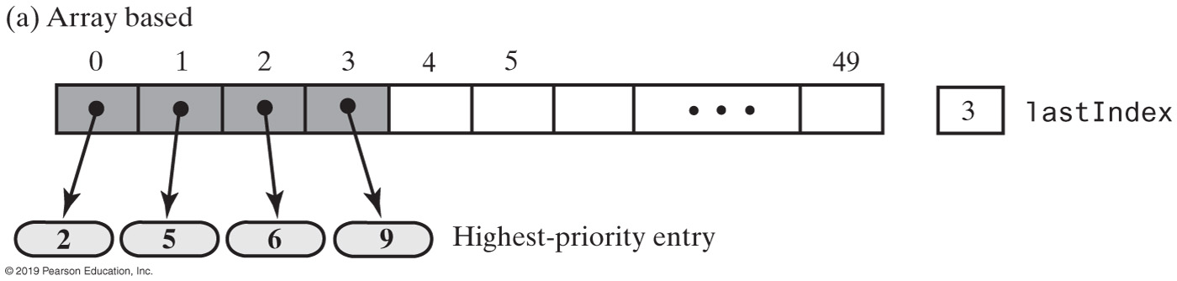
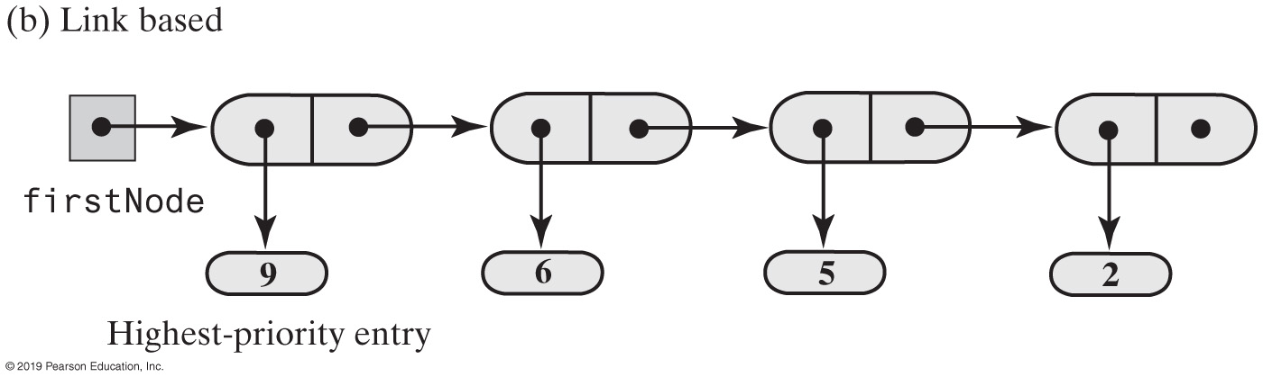
Possible Implementations of a Priority Queue
FIGURE 8-21 Two possible implementations of a priority queue

Slide 28
Which of these ADTs are FIFO?
queue
deque
priority queue
all of the above
only A and C
only F

Slide 29
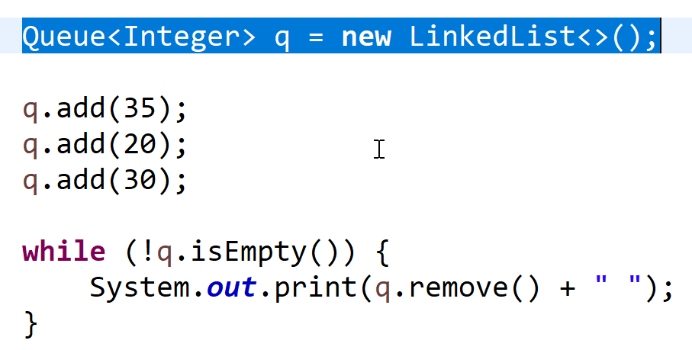
What will be printed?
35 20 30
30 20 35
20 30 35
35 30 20

Slide 30
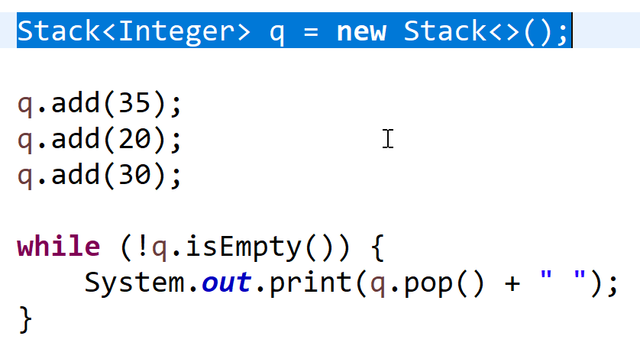
What will be printed?
35 20 30
30 20 35
20 30 35
35 30 20

Slide 31
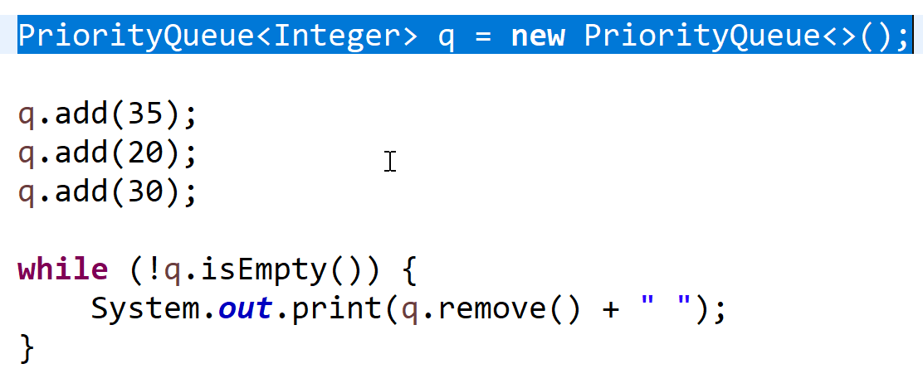
What will be printed?
35 20 30
30 20 35
20 30 35
35 30 20

Slide 32
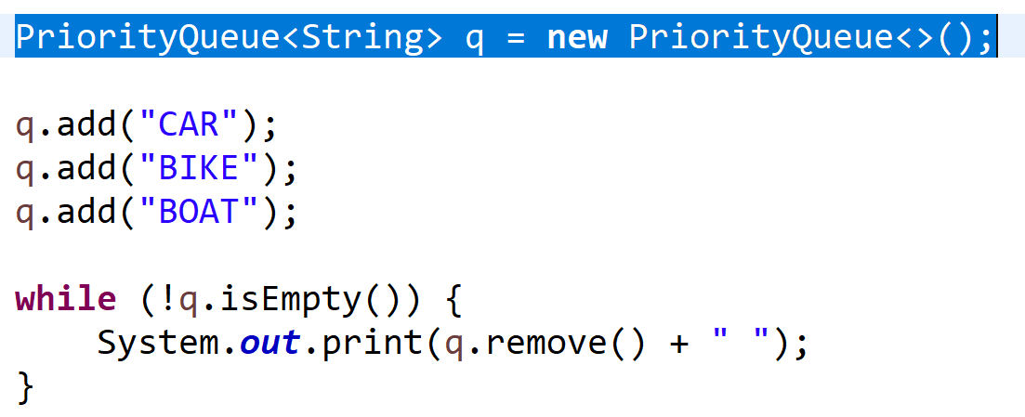
What will be printed?
BIKE BOAT CAR
CAR BOAT BIKE

Slide 33
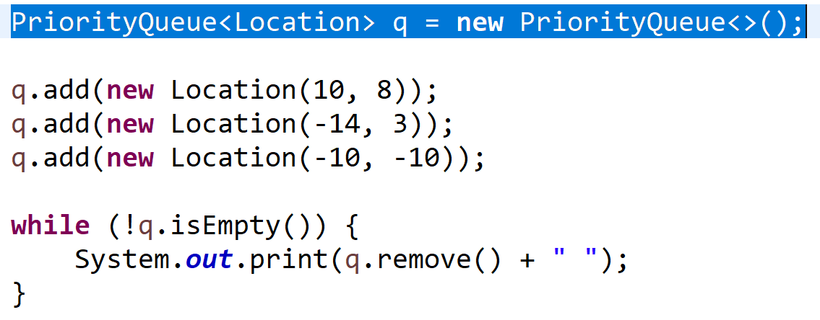
What will be printed?
(-10, -10) (-14, 3) (10, 8)
(-14, 3) (10, 8) (-10, -10)
(10, 8) (-14, 3) (-10, -10)
Need more information

Slide 34
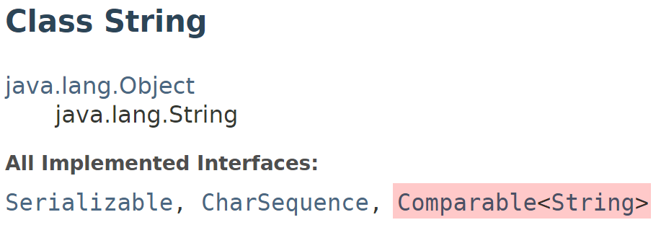
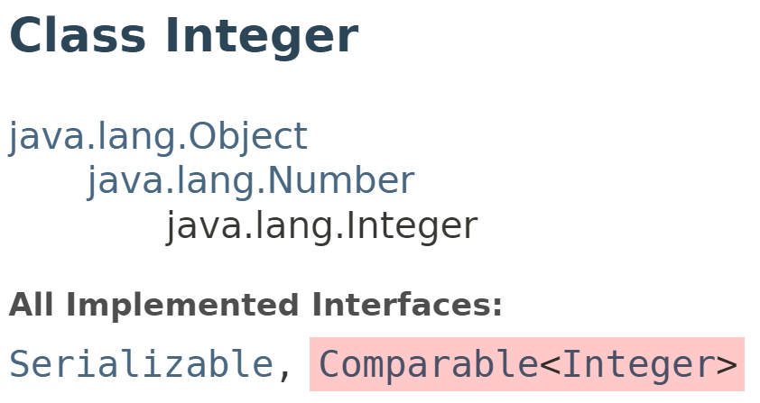
What information determines priority?
The compareTo() method.
You can only put objects in a priority queue if they implement the Comparable interface.

Slide 35
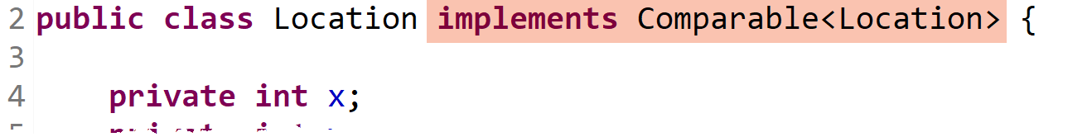
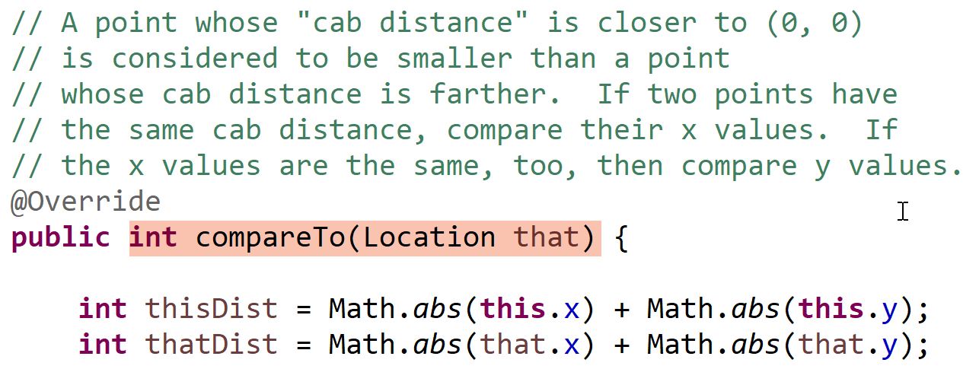
Putting your own objects in a PriorityQueue
Design your class to implement the Comparable interface:
Implement the compareTo() method:

Slide 36
What will be printed?
(-10, -10) (-14, 3) (10, 8)
(-14, 3) (10, 8) (-10, -10)
(10, 8) (-14, 3) (-10, -10)
Need more information, I wasn't listening.

Slide 37
Which data structure should never allow you to add null to it?
queue
stack
deque
priority queue
bag

Slide 38
END

